Slide 1

Decision Tree Regression

Slide 2
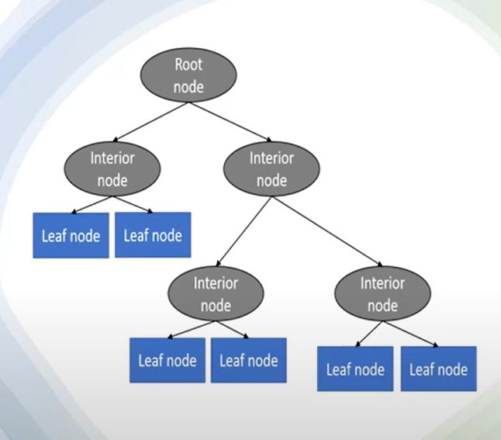
What is Decision Tree Regression?
Decision Tree is one of the most commonly used practicalapproaches for supervised learning.• It can be used to solve both Regression and Classification tasks(CART)•
It is a tree-structured with three types of nodes.•
The Root Node is the initial node which represents the entiresample and may get split further into further nodes
.• The Interior Nodes represent the features of a dataset, and the branches represent the decision rules. (internal)
• the Leaf Nodes represent the outcome. (Terminal)

Slide 3
How It Works
Starts with the entire dataset.
Selects the best feature to split the data to minimize error (usually MSE).,RSS
Recursively splits child nodes until a stopping condition is met (e.g., depth limit or min samples).
Final prediction is the mean of the target values in each leaf node.

Slide 4
Mathematical Concept(Loss Function)
Decision Trees for Regression use Mean Squared Error (MSE) to choose the best split:
MSE = (1/n) × Σ(actual - predicted)²
The algorithm chooses the split that results in the lowest total MSE across the branches.

Slide 5
Hyperparameters to Control Overfitting
max_depth: Maximum depth of the tree
min_samples_split: Minimum number of samples to split a node
min_samples_leaf: Minimum number of samples required in a leaf
from sklearn.tree import DecisionTreeRegressor
model = DecisionTreeRegressor(
max_depth=10,
min_samples_split=10,
min_samples_leaf=5,
random_state=42
)
model.fit(X_train, y_train)

Slide 6
Evaluation Metrics
se these to assess performance on test data:
Mean Squared Error (MSE)
Root Mean Squared Error (RMSE)
R² Score (Coefficient of Determination)
from sklearn.metrics import mean_squared_error, r2_score
y_pred = model.predict(X_test)
mse = mean_squared_error(y_test, y_pred)
r2 = r2_score(y_test, y_pred)

Slide 7
How to Improve
Pre-Pruning
Limit tree depth using max_depth, min_samples_split, etc.
Post-Pruning (Cost Complexity Pruning)
Remove unnecessary branches using ccp_alpha
cross-Validation & GridSearchCV
Tune hyperparameters automatically using
Gradient Boosting Regressor (GBR)
An ensemble model that builds multiple trees sequentially.
Each tree corrects the errors of the previous one.
Uses a technique called gradient descent to minimize the loss.

Slide 8

How GBR Works
Start with an initial prediction (e.g., mean of target).
Calculate residuals (actual - predicted).
Fit a new tree to predict these residuals.
Update prediction:

Slide 9
Key Parameters in GBR
n_estimators: Number of boosting stages (trees).
learning_rate: Shrinks contribution of eacAh tree (smaller = more accurate, slower).
max_depth: Depth of individual trees.
subsample: Fraction of samples used per tree (helps regularization).
loss: Function to optimize (default = least squares).
from sklearn.ensemble import GradientBoostingRegressor
from sklearn.model_selection import GridSearchCV
param_grid = {
'n_estimators': [100, 200],
'learning_rate': [0.01, 0.1],
'max_depth': [3, 5],
'min_samples_leaf': [1, 3],
}
grid = GridSearchCV(GradientBoostingRegressor(), param_grid, cv=5)
grid.fit(X_train, y_train)

Slide 10
Both XGBoost and LightGBM are powerful gradient boosting frameworks.
Designed for speed, accuracy, and scalability on large datasets.
Work well in Kaggle competitions and real-world applications.
What is XGBoost?
Stands for Extreme Gradient Boosting.
A regularized boosting algorithm that improves performance and avoids overfitting.
Can be used for both regression and classification tasks.

Slide 11
Key Features of XGBoost
✅ Regularization (alpha, lambda) to reduce overfitting ✅ Handles missing data internally ✅ Built-in cross-validation ✅ Parallel and distributed computing ✅ Supports tree and linear models
XGBoost Hyperparameters
n_estimators: Number of trees
learning_rate: Shrinks each tree’s contribution
max_depth: Depth of each tree
subsample: Row sampling
colsample_bytree: Feature sampling
reg_alpha, reg_lambda: L1 & L2 regularization

